Slide 1
Numerical Analysis
Seminar Session 2
Russell Kabir, PhD

Slide 2

Contents
Introduction
Different types of data
Distribution
n Questions and Answers

Slide 3
Session to be recorded
Please turn on microphone to talk or type in the chat box.
If not talking, please keep microphone on mute.
There will be opportunity for questions at the end too.

Slide 4
What is Data?
Facts or figures, which are numerical or otherwise, collected with a definite purpose are called data.

Slide 5
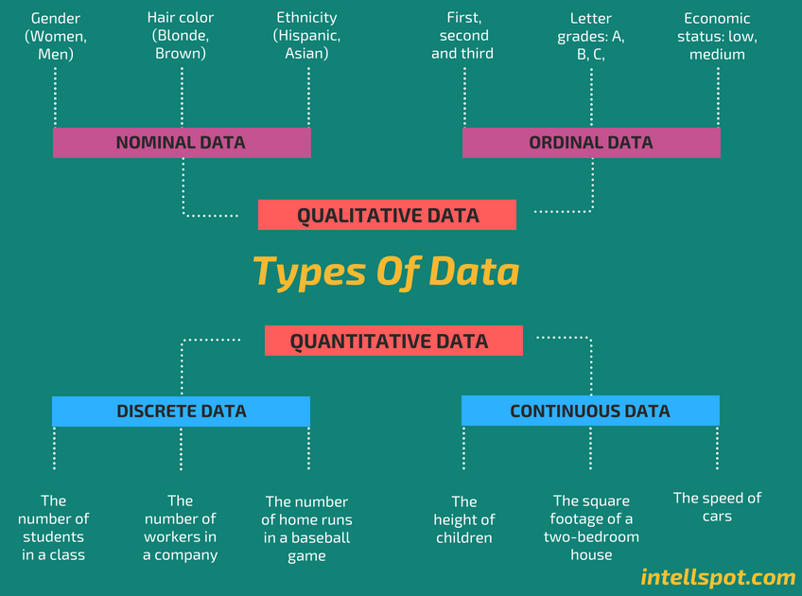

Slide 6
Discrete Vs continuous
Discrete data (countable) is information that can only take certain values. These values don’t have to be whole numbers but they are fixed values – such as shoe size, number of teeth, number of kids, etc.
Discrete data includes discrete variables that are finite, numeric, countable, and non-negative integers (5, 10, 15, and so on).
Continuous data (measurable) is data that can take any value. Height, weight, temperature and length are all examples of continuous data.
Continuous data changes over time and can have different values at different time intervals like weight of a person.

Slide 7
Another type
Interval data is data that has equal intervals between the values. This means that the difference between any two adjacent values is the same. For example, the temperature in degrees Celsius is interval data. The difference between 20 degrees Celsius and 21 degrees Celsius is the same as the difference between 30 degrees Celsius and 31 degrees Celsius.
Ratio data is data that has a meaningful zero. This means that the zero value represents the absence of something, and that there is no negative values. For example, height is ratio data. A person cannot be zero centimeters tall, and there are no negative heights.

Slide 8
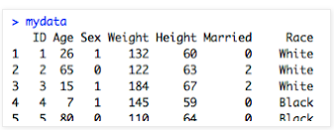
Sample data matrix in R

Slide 9
Activity 1
Are the following ratio, interval, ordinal or nominal data? And why do they meet each classification?
Number of males and females in a primary school
A depression rating scale
A pain scale
The number of people from each region of the UK who voted for a labour government
Money in pence
An intelligence rating scale
The number of children in a swimming club who received gold, silver and bronze awards
Weight measurements from a cohort of ladies in a slimming club
A patient satisfaction survey
Notes:
Age
20
23 45
34
30
45
50
Below 30= 0
Above 30=1
Sometimes. =yes
Often
Always
Not at all= no

Slide 10
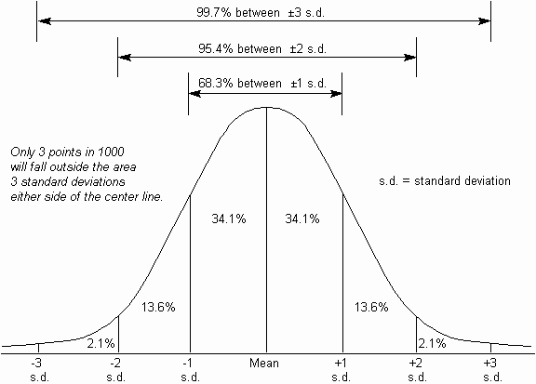
Distribution : the Normal Distribution
Suppose we measure a ‘naturally occurring’ V (perhaps not salary!) in a big enough sample and plot frequency (y-axis) for each ‘standardised’ value (x-axis) of V
Standard Normal Distribution
First, ‘standardise’ scores:
z = each score - mean
SD
(‘standardising’: this way you can compare between populations & between Vs with different scales)
Plot z-scores…
Symmetrical around 0 as the mean (= median = mode)
Most people (>95%) lie in 2 SDs either side of mean
Tails trail off beyond to meet x-axis at infinity

Slide 11
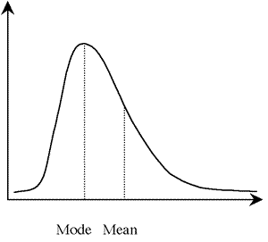
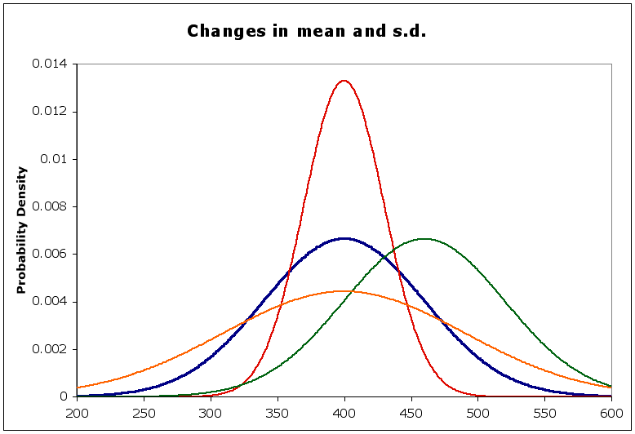
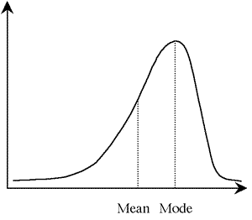
Other Distributions Skewness and Kurtosis
Skewed distribution
Asymmetrical
Mean not = typical value
Kurtosis
+ sharper than normal
- flatter than normal

Slide 12
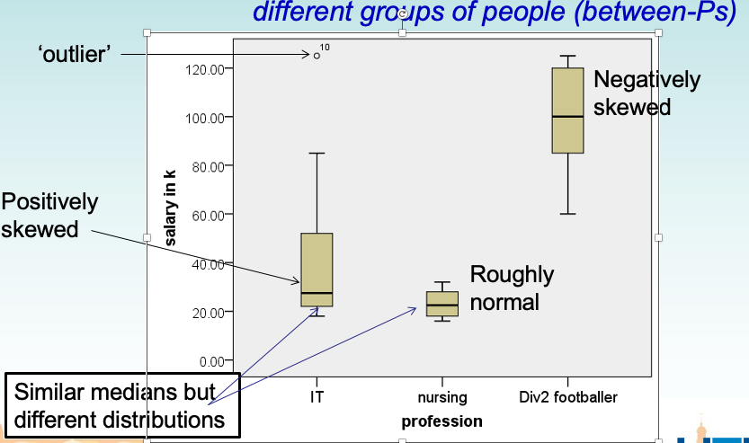
Comparing Distributions: Box Plots

Slide 13
Activities

Slide 14
Grouped Frequency Distribution
These are the numbers of newspapers sold at a local shop over the last 10 days:
22, 20, 18, 23, 20, 25, 22, 20, 18, 20
Papers sold | Frequency
18 | 2
19 | 0
20 | 4
21 | 0
22 | 2
23 | 1
24 | 0
25 | 1

Slide 15
Grouped Frequency Distribution
Now we can group them and present them in the following format-
Papers sold | Frequency
15-19 | 2 (%)
20-24 | 7
25-29 | 6
30-34 | 5
35-39 | 3
Notes:
Present the values in %
Total=2/23
Can you see cluster in this?
We can see the cluster from 20- 34.

Slide 16
Activity 1:
The list of IQ scores are: 118, 123, 124, 125, 127, 128, 129, 130, 130, 133, 136, 138, 141, 142, 149, 150, 154.
Do a Frequency Distribution Table with classes.
Notes:
118-123=2
124-130=6
131-136=2
137 or above=6

Slide 17
Activity 2
Listed below are the maximum daily temperatures (in degrees Celsius) in Iqaluit from June 2 to June 16: 2.8, 7.3, 9.6, 8.9, 11.4, 6.7, 5.8, 5.5, 6.7, 6.2, 9.0, 8.2, 7.6, 8.5, 6.7
Find the range
Find the interquartile range
(c) Find the median
Notes:
First order them
Range= 11.4-2.8
IQR= 2.7
Q1=6.2
Q3=8.9
Median=7.3
N+1/2=15+1/2=8
N+1/4=16/4=4
3 x N+1/4=
IQR=q3-q1

Slide 18
Next Seminar = 12 December 2023 at 9:30 am (UK time)
Questions?

